Slide 1


ATLIQ MART PROMOTIONS REPORT
MENTORS
Dhaval Patel
Hemanand Vadivel
PRESENTER
N.RAHUL
a.k.a Peter Pandey

Slide 2
Table of Contents
Problem statement
Objectives
Insights

Slide 3
Problem statement
AtliQ Mart is a retail giant with over 50 supermarkets in the southern region of India. All their 50 stores ran a massive promotion during the Diwali 2023 and Sankranti 2024 (festive time in India) on their AtliQ branded products. Now the sales director wants to understand which promotions did well and which did not so that they can make informed decisions for their next promotional period.
Sales director Bruce Haryali wanted this immediately but the analytics manager Tony is engaged on another critical project. Tony decided to give this work to Peter Pandey who is the curious data analyst of AtliQ Mart. Since these insights will be directly reported to the sales director, Tony also provided some notes to Peter to support his work.

Slide 4
Objectives
1. To Provide a list of products with a base price greater than 500 and that are featured in promo type of 'BOGOF' (Buy One Get One Free).
2. To Generate a report that provides an overview of the number of stores in each city.
3. To Generate a report that displays each campaign along with the total revenue generated before and after the campaign.
4. To Produce a report that calculates the Incremental Sold Quantity (ISU%) for each category during the Diwali campaign and also to provide rankings for the categories based on their ISU%.
5. To Generate a report featuring the Top 5 products, ranked by Incremental Revenue Percentage (IR%), across all campaigns.

Slide 5
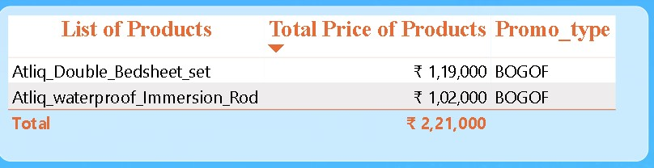
Business Request 1
select distinct product_code,product_name from(Select f.product_code,p.product_namefrom fact_events f inner join dim_products p on f.product_code=p.product_codewhere f.base_price>500 and f.promo_type="BOGOF") tt;
1.INSIGHTS:
A list of products with a base price greater than 500 and that are featured in promo type of 'BOGOF' (Buy One Get One Free).

Slide 6
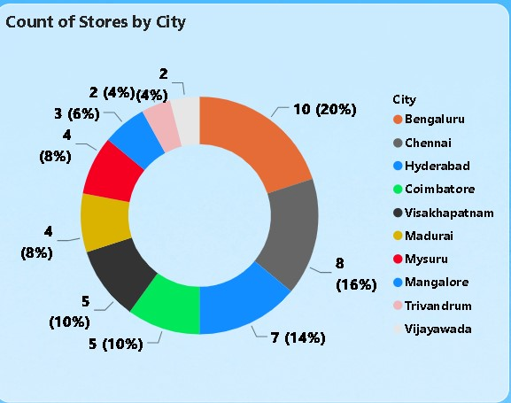
Business Request 2
Select city, count(store_id) as store_countfrom dim_storesgroup by cityorder by store_count desc;
2.INSIGHTS:
A report that provides an overview of the number of stores in each city.

Slide 7
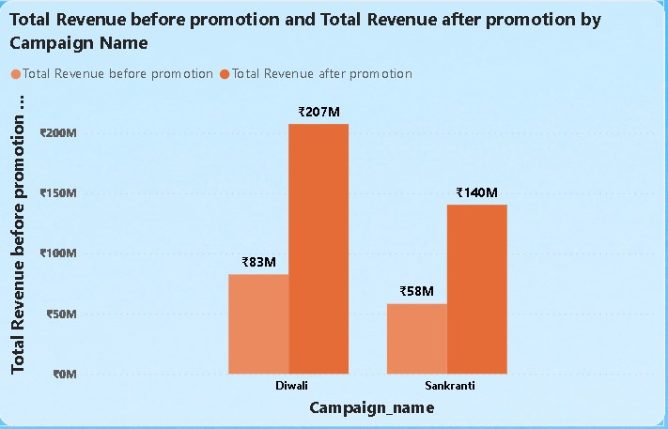
Business Request 3
select c.campaign_name,sum(base_price*quantity_sold_before_promo) as revenue_before_promo,sum(base_price*quantity_sold_after_promo) as revenue_after_promofrom fact_events f inner join dim_campaigns c on f.campaign_id=c.campaign_idgroup by c.campaign_name;
3.INSIGHTS:
A report that displays each campaign along with the total revenue generated before and after the campaign.

Slide 8
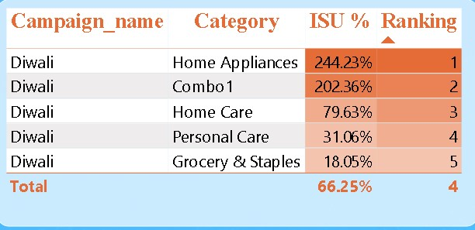
Business Request 4
select category, round(((qap-qbp)/qbp)*100,2) ISU%, rank() over(order by ((qap-qbp)/qbp)*100 desc) as ranking from(Select p.category,sum(quantity_sold_before_promo) as qbp, sum(quantity_sold_after_promo) as qapfrom fact_events f inner join dim_products p on f.product_code=p.product_codewhere f.campaign_id="CAMP_DIW_01"group by p.category ) as tt;
4.INSIGHTS:
A report that calculates ISU% for each category during the Diwali campaign and Ranking based on ISU %.
It measures the percentage increase in the quantity sold after the promotion compared to before the promotion.
The result is positive, it indicates an increase in the quantity sold.

Slide 9
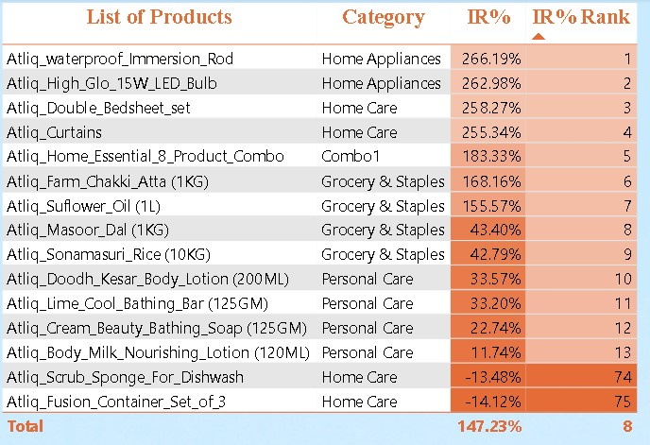
Business Request 5
select product_name,category, round(((rap-rbp)/rbp)*100,2) as IR% from(select p.product_name,p.category,sum(base_price*quantity_sold_before_promo) as rbp,sum(base_price*quantity_sold_after_promo) as rapfrom fact_events f inner join dim_products p on f.product_code=p.product_codegroup by product_name,category) tt order by IR% desclimit 5;
5.INSIGHTS: A report featuring the Top 5 products, ranked by Incremental Revenue Percentage (IR%), across all campaigns.
The negative incremental revenue percentage (-13.48% and -14.12%) indicates that the revenue decreased by -13.48%, -14.12% after the promotion compared to before the promotion.
Negative incremental revenue percentage typically suggests that the promotion was not effective in increasing revenue and may have even had a detrimental impact on revenue.

Slide 10
THANK YOU!!!!!!

